Slide 1
Marketing Targets

Slide 2
Team:
NAME | ROLLNO
B.SNEHITHA | 2003A52021
K.MAHALAXMI | 2003A52034
NAGARAJ | 2003A52042

Slide 3
Abstract:
Marketing data analysis is a technique where the business will take all the available information regarding the market and come up with a marketing plan.
It is a very vital piece of activity for any sort of business. It also shows you how well you have done in the market using your current marketing techniques.
Already existing solutions would be the predictive sales after marketing but in this problem statement we used various modes of marketing.
The future scope for the project will be that as the main aim of this project is to know the relation among the sales ang the mode of marketing platform, the users can analyze and choose best platform so that they get maximum profits.
By using this they need not invest their money in all the modes of marketing but instead choose a best one. In other mays it will also help the user to know how much average amount need to be spent for marketing.

Slide 4
Problem Statement:
The problem statement we encountered is to find out the difference between the previous sales as well as the sales once after the product is being advertised through different platforms.
Objective of this paper is to develop a system that predicts the rate of sales in specific year is increased or decreased. This is taken into consideration after observing all the amount spent on different modes of advertising like tv ads, radio ad, social media sponsoring and being advertised or suggested by any of the influencer.

Slide 5
Attribute information
Brand_name | Name of the Brands(Companies)
Year | Year between 2000-10
TV | Amount spend for advertising in TV in millions
Radio | Amount spend for advertising in Radio in millions
Social Media | Amount spend for advertising in Social Media in millions
Influencer | Amount spend for advertising in Influencer in millions
Sponsoring | Amount spend for advertising in Sponsoring in millions
location | Urban or Rural
Pre_Sales | Annual amount to the company before advertising
Aft_sales | Annual amount to the company after advertising

Slide 6
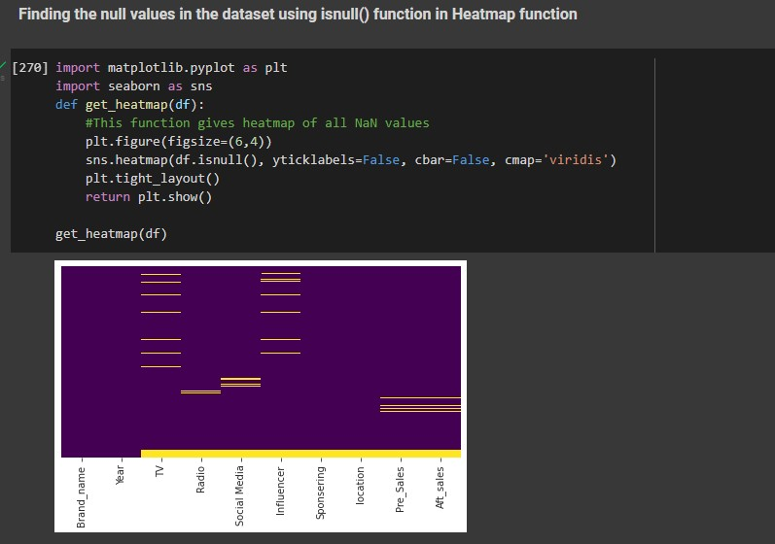
VISUALIZATION: Finding nan values

Slide 7
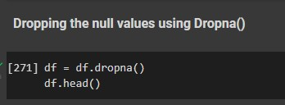
Dropping nan values:

Slide 8
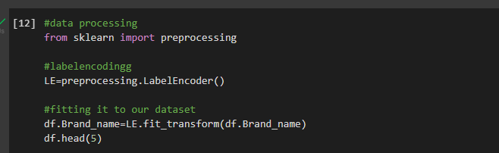
Label encoding to convert string into numerical:

Slide 9
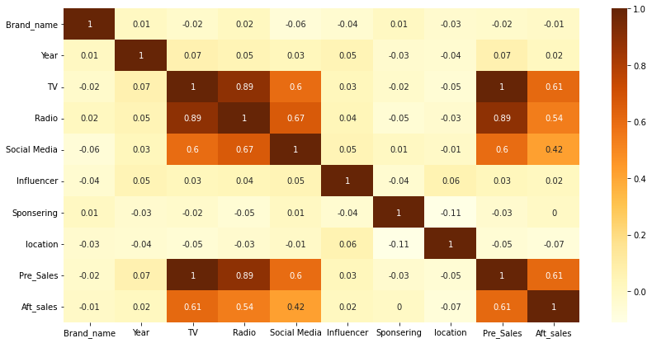
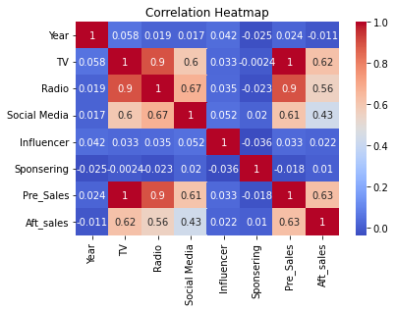
CORRELATION MATRIX:
sns.
heatmap
(
df1.corr
()
,
annot=
True
,
cmap=
"coolwarm"
)
plt.title
(
"Correlation
Heatmap"
)
plt.show
()

Slide 10

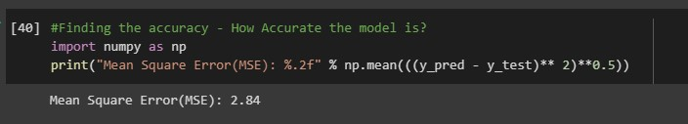
Model selection
This is a regression-based model which will predict the increase in sales of brand after advertising their products.
So we have selected Linear Regression.
For Linear Regression, we use the Mean Squared Error (MSE) cost function, which is the average of squared error occurred between the predicted values and actual values. It can be written as:

Slide 11
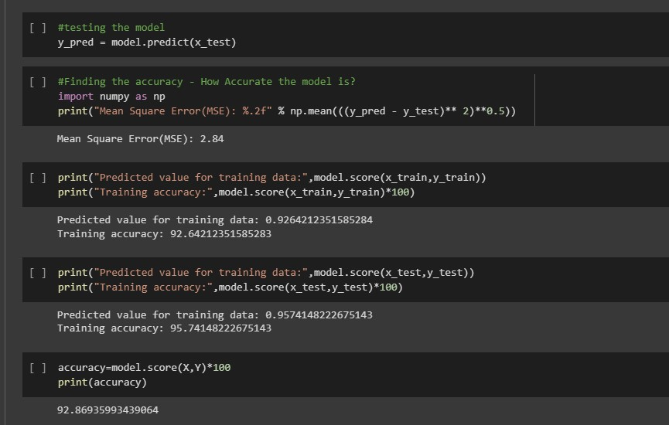
ACCURACY

Slide 12
CONCLUSION:
The conclusion of our analysis is that, advertising a key role in increasing of sales of any product.
From the dataset we have took very few categories of advertising platforms but there are many other platforms also.
As seen in the visualization product sales before marketing and after marketing are changed after the model being trained considering the amount spent on marketing.
The future scope for the project will be that as the main aim of this project is to know the relation among the sales ang the mode of marketing platform, the users can analyze and choose best platform so that they get maximum profits.
By using this they need not invest their money in all the modes of marketing but instead choose a best one.
In other mays it will also help the user to know how much average amount need to be spent for marketing.

Slide 13
THANK YOU!!!

